Slide 1


GUJARAT TECHNOLOGICAL UNIVERSITY
Chandkheda, Ahmedabad Affiliated
C. K. Pithawala College of Engineering and Technology
B. E. IV, Semester – VII (ECE Branch)
Final Year Project : Lungs Disease (Pneumonia) Prediction using Deep Learning
Group : 1 Guide : Dr. Mita C. Paunwala , Dr. Amisha J. Shah
Sr. no | Name | Enrollment .no | Year
1 | Rahul Sivadasan | 170090111019 | 4th Year (sem – 7)
2 | Ashwin Channar | 170090111002
3 | Kisan Pandya | 170090111012
4 | Anand Singh | 140090111056

Slide 2
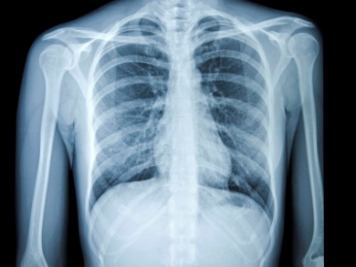

TITLE
Lungs Disease (Pneumonia) Prediction
using

Slide 3
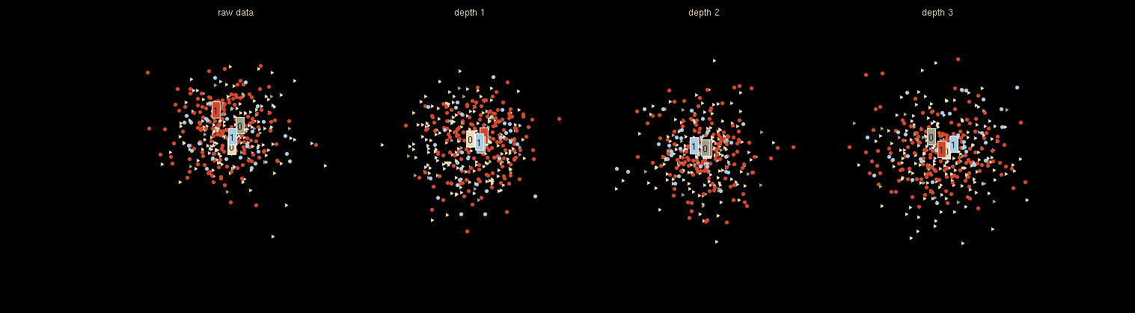
OVERVIEW
8 Literature Surveys
Conclusion
Our Approach
Work Distribution and Time period
References

Slide 4
LITERATURE SURVEY
Research paper | Accuracy | Year | Data set Images | Author
CheXNET: Pneumonia Detection on Chest X-rays with Deep Learning [1] | 76.80 | 2017 | 1,00,000 | Pranav Rajpurkar , Jeremy Irvin , Kaylie Zhu , Brandon Yang , Hershel Mehta , Tony Duan , Daisy Ding , Aarti Bagul , Robyn L. Ball, Curtis Langlotz , Katie Shpanskaya , Matthew P. Lungren , Andrew Y. Ng
Classification of Bacterial and Viral Childhood Pneumonia Using Deep Learning in Chest Radiography [2] | 82.34 | 2018 | 4,892 | Xianghong Gu , Liyan Pan , Huiying Liang , Ran Yang

Slide 5
LITERATURE SURVEY
Research paper | Accuracy | Year | Data set Images | Author
Diagnosis of Pneumonia from Chest X-Ray Images Using Deep Learning [3] | 87.34 | 2019 | 5,856 | IEEE
Automatic Detection of Pneumonia on Compressed Sensing Images using Deep Learning [4] | 91.16 | 2019 | 5,863 (Kaggle) | IEEE

Slide 6
LITERATURE SURVEY
Research paper | Accuracy | Year | Data-set Images | Author
A Novel Transfer Learning Based Approach for Pneumonia Detection in Chest X-ray Images [5] | 92.86 | 2020 | 5,232 | Vikash Chouhan , Sanjay Kumar Singh , Aditya Khamparia , Deepak Gupta , Prayag Tiwari , Catarina Moreira , Robertas Damaševičius and Victor Hugo C. de Albuquerque
Diagnosing COVID-19 Pneumonia from X-Ray and CT Images using Deep Learning and Transfer Learning Algorithms [6] | 94.1 | 2020 | 46,096 | Halgurd S. Maghdid, Aras T. Asaad, Kayhan Zrar Ghafoor, Ali Safaa Sadiq, Muhammad Khurram Khan

Slide 7
LITERATURE SURVEY
Research paper | Accuracy | Year | Data-set Images | Author
Efficient Pneumonia Detection in Chest X Ray Images Using Deep Transfer Learning [7] | 97.3 | 2020 | 5836 | Mohammad Farukh Hashmi , Satyarth Katiyar , Avinash G Keskar , Neeraj Dhanraj Bokde , and Zong Woo Geem
A Deep Transfer Learning Framework for Pneumonia Detection from Chest X-ray Images [8] | 98.63 | 2020 | 5000 | Kh Tohidul Islam , Sudanthi Wijewickrema , Aaron Collins and Stephen O’Leary

Slide 8
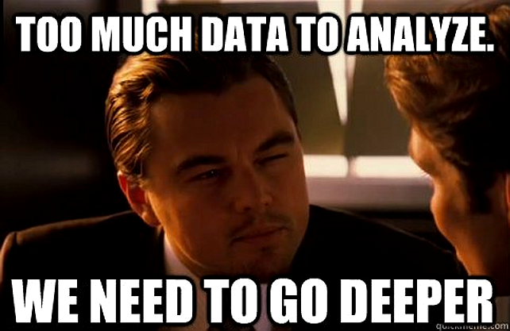

Slide 9
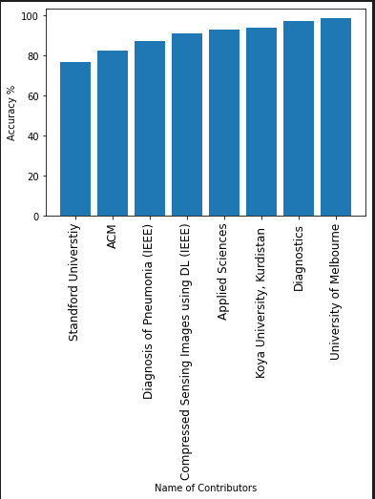
CONCLUSION
After Surveying all the Research paper we understood with the use of Transfer learning approach we can have the highest Accuracy .

Slide 10
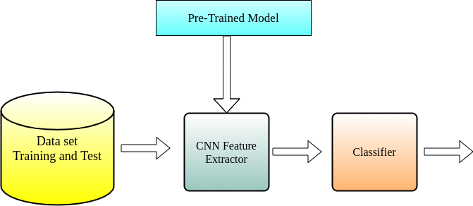
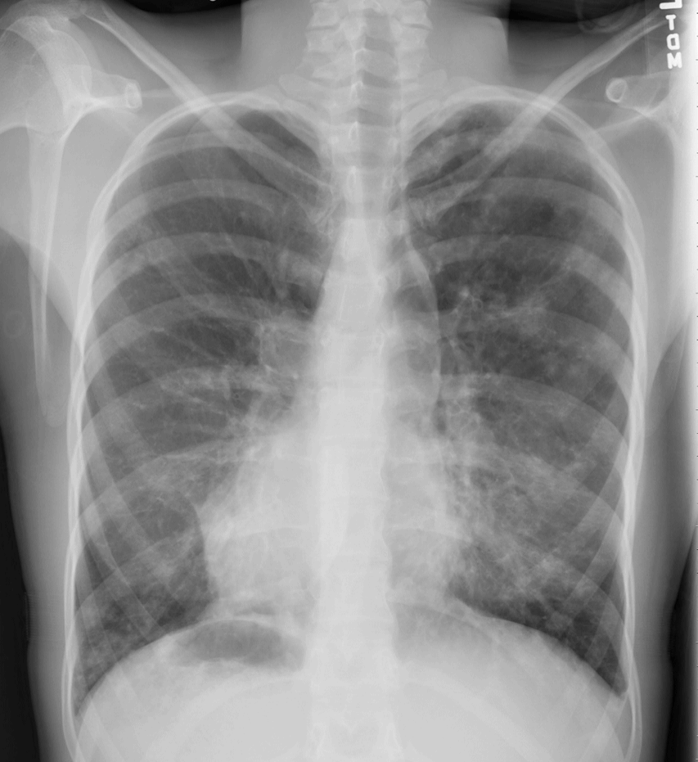
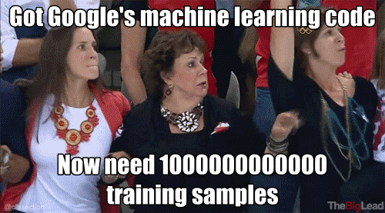
OUR APPROACH
Transfer Learning
Dataset
Kaggle
Training Data (5364 images)

Slide 11
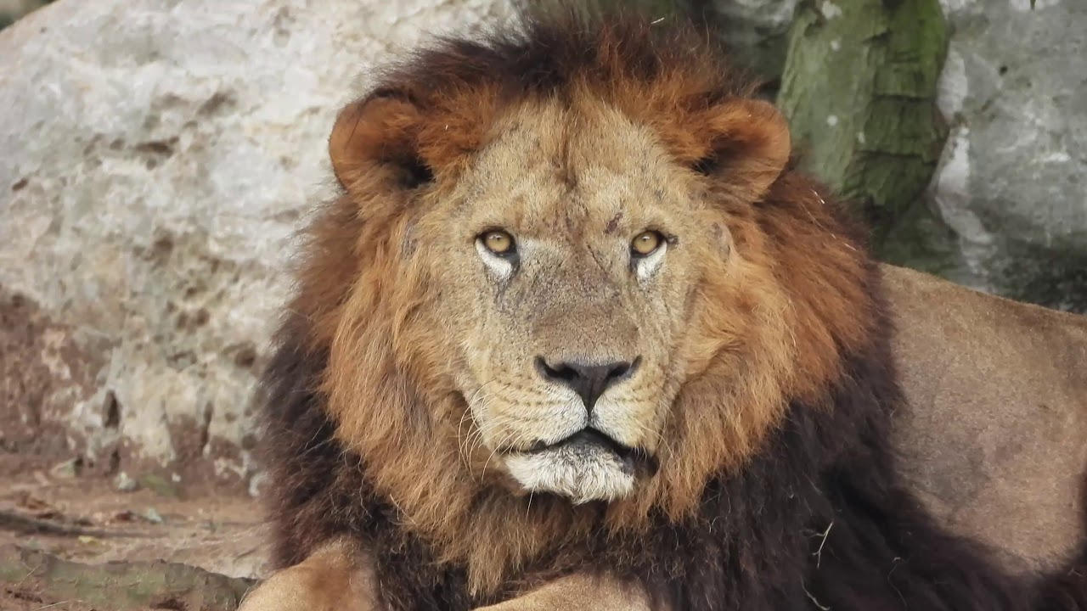
CNN - Convolutional Neural Network
0 or 1
Layer

Slide 12
WORK DISTRIBUTION
Working on Machine learning and Backend
Rahul Sivadasan
Creating the Web application
Ashwin Channar
Kisan Pandya
Designing of the Project : UI/UX
Anand Singh
Work on understanding of GPU

Slide 13
Time period
September
Phase - 1 (a)
Learn the CNN and Transfer Learning and other additional things
October
Phase - 1 (b)
Build the First Prototype and Test it using Kaggle Dataset
November
Phase -2 (a)
Will work on Learning about more things related to projects and Improve the prototype.
December
Phase-2 (b)
Will work with Real Time data on the improved Prototype and look for improvements
January
Phase-3 (a)
Final Project version will be made and will be trained using real time Data
February
Phase-3 (b)
End to End Completion of Project with a Web app and it will be Deployed using some Cloud Service

Slide 14
References
[1] https://arxiv.org/pdf/1711.05225.pdf
[2] https://ieeexplore.ieee.org/stamp/stamp.jsp?tp=&arnumber=8741582
[3] https://ieeexplore.ieee.org/stamp/stamp.jsp?tp=&arnumber=8861969
[4] https://arxiv.org/pdf/2004.00038.pdf
[5] https://www.mdpi.com/2075-4418/10/6/417
[6] https://www.mdpi.com/2076-3417/10/2/559
[7] https://dl.acm.org/doi/
[8] https://www.researchgate.net/profile/Kh_Tohidul_Islam/publication/

Slide 15
THANK YOU

